Slide 1
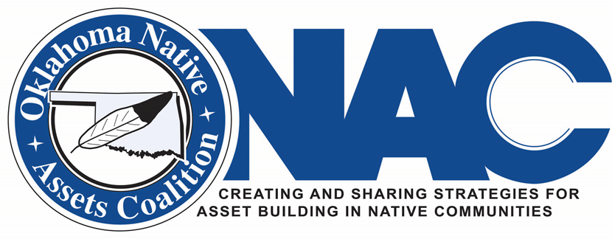
Discover the Oklahoma Native Assets Coalition, Inc.
Presentation by the Oklahoma Native Assets Coalition, Inc.
for the National Indian Council on Aging, Inc.
December 10, 2020

Slide 2
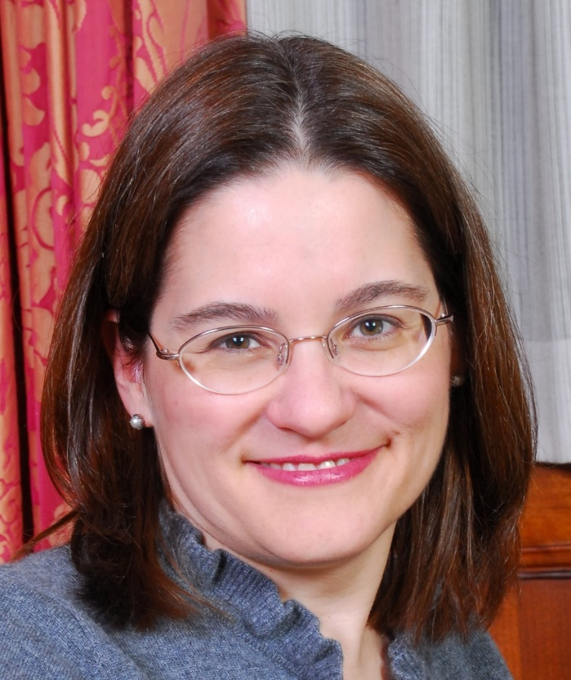
Oklahoma Native Assets Coalition, Inc. (ONAC)
Christy Finsel, Citizen of the Osage Nation
Executive Director
Oklahoma Native Assets Coalition, Inc.
cfinsel@oknativeassets.org
www.oknativeassets.org

Slide 3
The Oklahoma Native Assets Coalition, Inc. (ONAC) is an American Indian-led nonprofit Native asset building coalition that collaborates with Native nations and other interested partners to offer Native-led and culturally compatible asset-building programs and initiatives in Native communities. The coalition, started in Oklahoma and headquartered in Oklahoma City, has existed since 2001, and was classified by the Internal Revenue Service as a 501(c)(3) nonprofit in 2014. ONAC focuses on promoting culturally responsive asset-building strategies and serves Native communities on a national level.

Slide 4
Addressing the Racial Wealth Gap and Promoting Financial Equity through Native Asset Building Programs
ONAC has a commitment to reducing racial and women’s wealth gaps; a commitment that goes beyond supporting tribes and other Native-led nonprofits engaged in Native asset building initiatives. ONAC also directly administers asset building programs that work to close these wealth gaps through integrated and wrap-around programs that promote financial equity.
Given the tribal populations we serve, the families with lower incomes that participate in our programs, and that we are a Native-led asset building coalition, all of our programming is designed to reduce the racial wealth gap.

Slide 5
ONAC’s Interrelated Asset-Building Programs and Initiatives
Current Native-specific programs and initiatives include:
  Mini-grant program (AI/AN)
  National Native EITC/VITA Network
  Training, TA, and national research
  Prevention of frauds and scams
  Native small business resources
  General financial coaching/homebuyer education/credit counseling program
  Native-specific financial education (youth booklet and CSA-related investor education)
  Children’s Savings Account program
  Emergency Savings Account program
  ONAC COVID-19 emergency cash assistance program
  Native Bank On ONAC initiative
www.oknativeassets.org

Slide 6
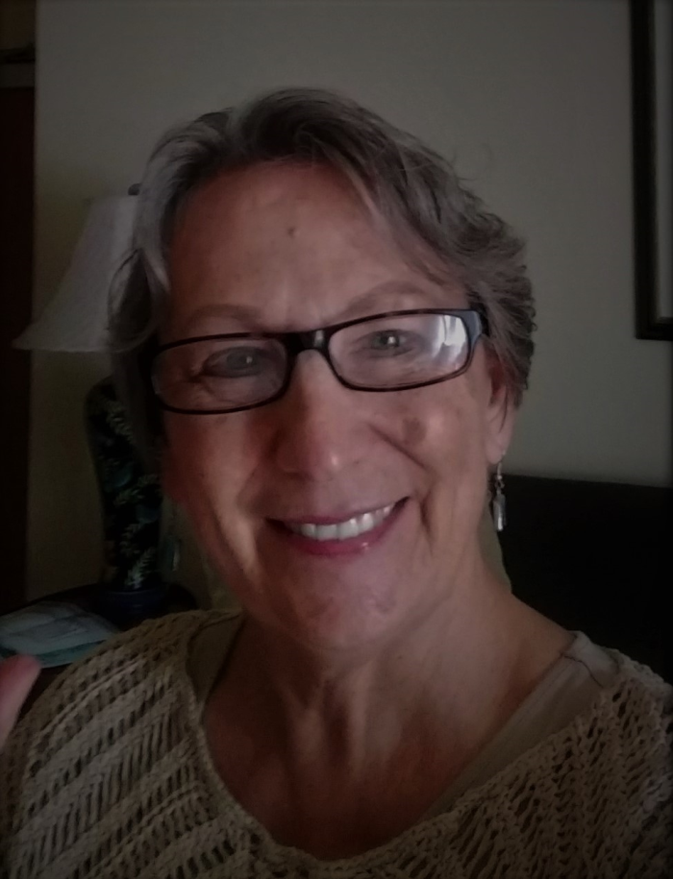
Native Bank On ONAC
Karen Edwards
Manager
Native Bank On ONAC
Citizen of the Choctaw Nation
kedwards@oknativeassets.org

Slide 7
A First: Native Bank On ONAC
Native Bank On ONAC is the first and only Bank On initiative to focus its efforts primarily on Native communities.
A main goal of Native Bank On ONAC is to partner with tribes and tribal communities to increase financial institution access for tribal citizens.
Native Bank On ONAC works with tribes and other partners to connect tribal citizens to safe and affordable financial products that are certified to meet Bank On National Account Standards.
More specifically, Native Bank On ONAC: Pilots accounts in Oklahoma with three initial integrations; shares information nationally about how Bank On assists in receiving Economic Impact Payments (EIPs); has opened communication with two Native owned banks regarding offering nationally available accounts; shares lessons learned with Native communities as they pursue Bank On integrations in their areas.

Slide 8
Native Bank On ONAC Certified Account Banking Partners In Oklahoma
Active Integrations
AllNations Bank with branches in Calumet and Shawnee, OK (a bank owned by Absentee Shawnee Tribe of Oklahoma) offers a Bank On NAS certified account
ONAC: AllNations Bank & EIP Checks
First State Bank of Anadarko with branches in Anadarko and Gracemont, OK ( a privately owned bank working in partnership with The Wichita and Affiliated Tribes) offers a Bank On NAS certified account
ONAC: First State Bank Anadarko & EIP Checks
BancFirst has a number of branches throughout OK, flyers are currently being distributed by the Cherokee Nation Commerce Group regarding a Native Bank On ONAC incentive for opening BancFirst’s NAS certified account
ONAC: Flyer Regarding Incentives

Slide 9
Recently Released Resources from ONAC
Going Remote: Providing Native-Specific Financial Education and Coaching in a Virtual Setting
Native Women Business Owners: Building Assets, Strengthening their Communities, and Working to Close the Women’s Wealth Gap
Native Voluntary Income Tax Assistance (VITA) Program Experiences of Providing Remote and/or Socially Distanced Services During the COVID-19 Pandemic
Native Children’s Savings Initiatives in the United States
Interim Data Report on ONAC Emergency Savings Account Initiatives
Claiming EIP Payments
Native Bank On informational handouts

Slide 10
To Get More Involved:
Join ONAC email distribution group, email Christy Finsel at cfinsel@oknativeassets.org.
Join ONAC Native EITC/VITA Network. To join, email Patsy Schramm (Cherokee) at edgpj@aol.com (networking and sharing expertise).
For more information about Native Bank On ONAC, email Karen Edwards (Choctaw) at kedwards@oknativeassets.org.
ONAC general financial coaching/homebuyer education/credit counseling program is available to tribal citizens, by appointment, via phone or teleconference with Felecia Freeman (Citizen Potawatomi). To register, go to https://www.surveymonkey.com/r/ONACcounselingregistration.
Join as an ONAC member.
www.oknativeassets.org

