Slide 1
Tools for financial caregivers of older adults
NICOA Presentation
Office for Older Americans | January 2021

Slide 2
Disclaimer
This presentation is being made by a Consumer Financial Protection Bureau representative on behalf of the Bureau. It does not constitute legal interpretation, guidance or advice of the Consumer Financial Protection Bureau. Any opinions or views stated by the presenter are the presenter’s own and may not represent the Bureau’s views.
Note: This document was used in support of a live discussion. As such, it does not necessarily express the entirety of that discussion nor the relative emphasis of topics therein.
Notes:
Standard OA slide recently cleared by Kramer, K. for a Sept. 10, 2020 NCRC webinar.

Slide 3
The Bureau’s Mission and Vision
MISSION
To regulate the offering and provision of consumer financial products or services under the Federal consumer financial laws and to educate and empower consumers to make better informed financial decisions.
Free, innovative, competitive, and transparent consumer finance markets where the rights of all parties are protected by the rule of law and where consumers are free to choose the products and services that best fit their individual needs.
VISION
Notes:
Standard OA slide cleared by Kramer, K. in July 2020 for webinar with DOL-EBSA.
The Consumer Financial Protection Bureau regulates the offering and provision of consumer financial products and services under the Federal consumer financial laws, and educates and empowers consumers to make better informed financial decisions.

Slide 4
CFPB’s Office for Older Americans
The Office for Older Americans engages in research, policy, and educational initiatives, designed to:
help protect older consumers from financial harm
help older consumers make sound financial decisions as they age
Learn more about us at consumerfinance.gov/olderamericans
Notes:
Standard OA slide recently cleared by Kramer, K. for a Sept. 10, 2020 NCRC webinar.
The Office for Older Americans develops resources to help protect older consumers from financial harm and help older consumers make sound financial decisions as they age. We also help stakeholders by providing tools to support long-term financial security for older adults.
Today I want to tell you about the CFPB’s Managing Someone Else’s Money guide and other tools for financial caregivers.

Slide 5
Financial caregiving is challenging
Kristin in Virginia: “Even though I’m a financially savvy individual, I had no idea where to get help….”
Hector in Florida: “When you have to take care of someone else’s finances, you feel more responsible for their affairs than you do for your own. It’s overwhelming.”
Notes:
Slide recently cleared by Schifferle, L. for a July 29, 2020 CMS Caregiver Working Group presentation.
Approved by Haddadi, T. Office of Privacy, 1-30-20.
Millions of Americans are managing money or property for a loved one who is unable to pay bills or make financial decisions. This can be very overwhelming. With the coronavirus pandemic, more people may be called upon to act as financial caregivers. To help these financial caregivers, CFPB has four easy-to-understand booklets.

Slide 6
Managing Someone Else’s Money
Guides for financial caregivers

Slide 7
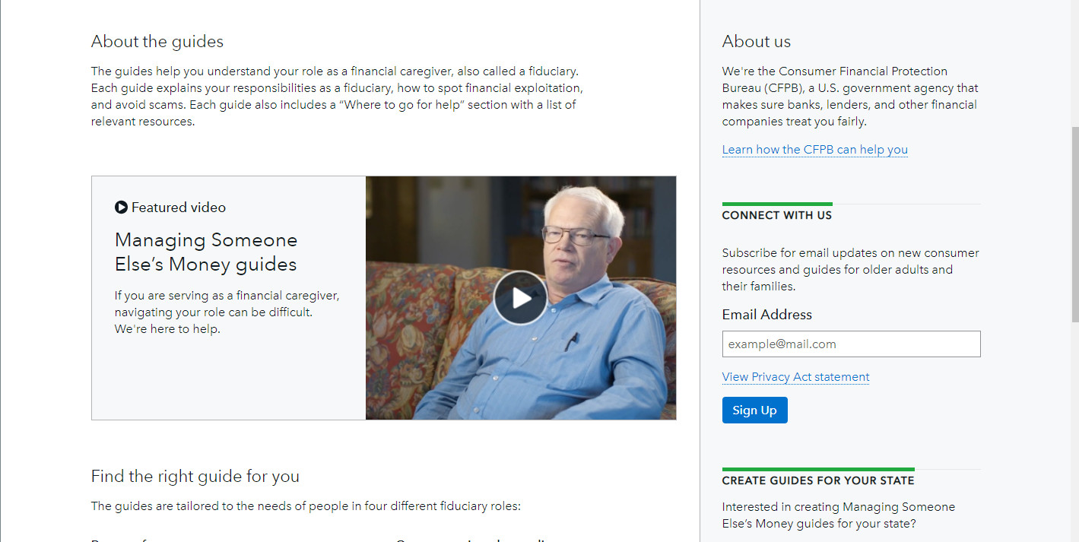
MSEM video – www.consumerfinance.gov/msem
Notes:
Slide recently cleared by Schifferle, L. for a July 29, 2020 CMS Caregiver Working Group presentation.
The CFPB’s four guides are to help family members and friends who are fiduciaries. A fiduciary is someone who is named to manage money or property for someone else. We have guides for four types of fiduciaries:
Agents under power of attorney
Guardians of property (sometimes known as conservators)
Trustees under revocable living trusts
Government benefits fiduciaries: Social Security representative payees and VA fiduciaries.
Guides help lay fiduciaries understand their duties:
Provide tips and resources to help fiduciaries protecting, investing, and managing money for a loved one
Include information on identifying benefits the care recipient may be eligible for, e.g. disability, Social Security, Medicare, Medicaid, Veterans benefits, housing assistance, or SNAP
Describe warning signs of financial exploitation, and how to watch out for consumer scams
Provide information on where to get help
The CFPB contracted and worked closely with the American Bar Association Commission on Law and Aging to prepare these guides.

Slide 8
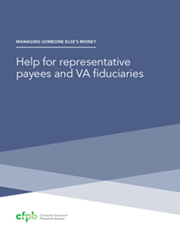

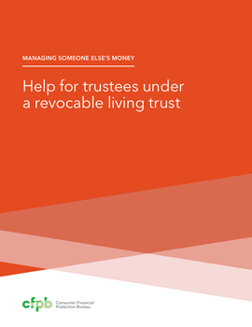
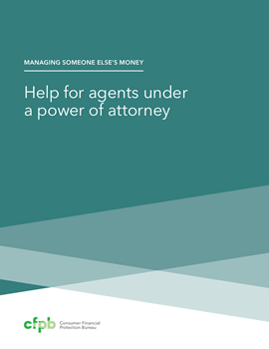
Managing Someone Else’s Money guides
Help for financial caregivers handling the finances for a family member or another who is unable
Guides for four common types of financial caregivers:
  Agents under a Power of Attorney
  Guardians and conservators
  Trustees
  Social Security and Department of Veterans Affairs (VA) representatives
Notes:
Slide recently cleared by Schifferle, L. for a July 29, 2020 CMS Caregiver Working Group presentation.

Slide 9
What is a fiduciary?
Anyone named to manage money or property for someone else
Agents under a Power of Attorney are named in a legal document
Guardians and conservators are named by a court
Trustees may be named in a legal document or a court
The Social Security and Department of Veterans Affairs (VA) may name representative payees
Notes:
Slide recently cleared by Schifferle, L. for a July 29, 2020 CMS Caregiver Working Group presentation.
Agents under a Power of Attorney are named in a legal document
Guardians and conservators can be named by a court
Trustees may be named in a legal document or a court
The Social Security and Department of Veterans Affairs (VA) may name representative payees

Slide 10
What is a power of attorney?
Legal document giving a financial caregiver authority to make decisions about money/property
  “Martina” names you Agent under a Power of Attorney.
  You can make decisions if illness or injury leaves Martina unable to make financial decisions
Health care Power of Attorney is different
Notes:
Slide recently cleared by Schifferle, L. for a July 29, 2020 CMS Caregiver Working Group presentation.
A power of attorney is a legal document. In it, someone (known as the principal) gives someone else (the agent) legal authority to make decisions about his or her money or property. Often people make powers of attorney so that someone else can handle their money if they become sick or injured and can no longer manage their own finances. In some states, this type of document is called a durable power of attorney. Powers of attorney are private arrangements, because they don’t involve appointment by a court or a public agency.
An individual also can make a health care power of attorney to name someone to make decisions about health care. The CFPB guide does not discuss health care powers of attorney.

Slide 11
What is a representative payee?
What is a VA fiduciary?
Government agencies may appoint someone to manage Martina’s benefits if she needs help
  Social Security Admin. - representative payee
  Department of Veterans Affairs - VA fiduciary
Representative payees and VA fiduciaries only manage Martina’s benefits – not financial affairs, other property, or medical matters
Notes:
Slide recently cleared by Schifferle, L. for a July 29, 2020 CMS Caregiver Working Group presentation. Notes below have not been previously cleared.
There is also information in MSEM on helping your loved one find public benefits. For example, there are many older adults who are eligible for food assistance but do not receive it. Finding benefits to help support your loved one financially may be another part of your role as a financial caregiver.
A government agency may appoint someone to manage income benefits for a person who needs help managing those benefits. The Social Security Administration and some other federal agencies call that person a representative payee. A representative payee only has authority to manage the benefit checks of the agency that made the appointment. If the beneficiary has other money or property that he or she cannot manage, a fiduciary must have legal authority from another source to manage anything other than the benefit checks. The CFPB’s guide is for Social Security representative payees and VA fiduciaries, but may be helpful to payees appointed by other federal or state agencies.

Slide 12
What is a guardian of property?
A court names someone to manage Martina’s money and property if it finds that she can’t manage it alone
Martina might also have a ‘guardian of the person’ if she can’t make her own health care or other decisions
Terms vary by state – (e.g., conservator, guardian of estate)
Notes:
Slide recently cleared by Schifferle, L. for a July 29, 2020 CMS Caregiver Working Group presentation.
A guardian of property is someone the court names to manage money and property for someone else whom the court has found cannot manage it alone. Sometimes a guardian of property is also appointed as guardian of the person. That means that the guardian can make health care and other personal decisions as well as financial decisions.

Slide 13
What is a trustee?
Fiduciary under a revocable living trust
  Martina signs a legal document called a living trust
  Martina transfers ownership of money and property to the trust
  Trustee can pay bills or make other financial and property decisions if Martina can no longer manage her money or property
Beneficiaries receive money or property from the trust
Notes:
Slide recently cleared by Schifferle, L. for a July 29, 2020 CMS Caregiver Working Group presentation.
A revocable living trust is a legal document. Someone makes a revocable living trust to give someone else legal authority to make decisions about money or property in the trust if she cannot make decisions herself because she is sick or injured. The trust also specifies who gets the money or property in the trust after the person who created it dies. The person who makes decisions about the money and property in the trust is called the trustee. There are other legal arrangements also known as trusts, but the CFPB guide only discusses revocable living trusts. Like powers of attorney, trusts are private arrangements.

Slide 14
What does it mean to be a fiduciary?
Can you use Martina’s money to buy yourself a new phone?
Can you use Martina’s money to fix your car?
Can you use Martina’s money to fix the roof of your home?
Can you give yourself a loan and pay it back later?
Notes:
Slide recently cleared by Schifferle, L. for a July 29, 2020 CMS Caregiver Working Group presentation.
MSEM, Duty 1: Act only in (Martina’s) best interest, p. 10
Guide discusses the issue of conflict of interest.
The answer to all of these questions is no.
Fiduciaries must safeguard the finances of the person they manage money for. This includes keeping that money and property separate from their own.
Gifts: “State law may allow Martina to decide whether a Power of Attorney may make gifts. Check the legal document to see whether Martina gave you the power to make gifts. Any gifts or loans should be in line with what Martina would have wanted. Even if the POA clearly allows gifts to you or others, be very careful to avoid conflicts of interest. For example, if Martina gave money every year to a charity, a durable POA may allow you to continue doing that. “

Slide 15
Duties of a fiduciary
Act only in the person’s best interest
Manage the money and property carefully
Keep the money and property separate
Keep good records
Notes:
Slide recently cleared by Schifferle, L. for a July 29, 2020 CMS Caregiver Working Group presentation.
Duties of a fiduciary – though note that this is not intended as legal advice and the specifics may vary based on the law of your state:
Acting only in the person’s best interest
Managing the money and property carefully
Keeping the money and property separate
Keeping good records
For example, part of acting in someone’s best interest is avoiding conflicts of interest. The guides provide scenarios that might pose a conflict. If you buy a car with Martina’s money and mainly drive the car for your own needs, that may be a conflict of interest.
Managing the money and property carefully includes compiling an inventory of money, property and debts; investing carefully, with the help of a financial professional; and finding out whether the person is eligible for any financial or health care benefits from an employer or government.
Keeping the person’s money separate means avoiding joint accounts. The guides discuss how to title bank accounts and how to sign checks on behalf of the person the fiduciary serves.
Keeping good records includes keeping receipts and notes, even for small expenses, and avoiding paying in cash. Can also help with benefits determinations and with POA abuse cases.

Slide 16
State-specific guides
We developed state-specific MSEM guides for
Professionals used our Tips and Templates Guide to create their own
  (Alabama, Idaho, Michigan, Nebraska, and Texas)
  Arizona
  Florida
  Georgia
  Illinois
  Oregon
  Virginia
Notes:
Slide recently cleared by Schifferle, L. for a July 29, 2020 CMS Caregiver Working Group presentation.
State-specific guides
Professionals in six states (Arizona, Florida, Georgia, Illinois, Oregon, and Virginia) worked with us to develop state-specific guides.
We’ve encouraged local organizations to develop their own guides by making a “Tips and Templates” guide to developing state-specific Managing Someone Else’s Money guides. These are available for download on the CFPB website. Using these tips and templates, organizations in Texas and Michigan have developed a full set of state-specific guides.
All guides, tips and templates for replicating the guides, and information on co-branding are available online.

Slide 17
Where to find Managing Someone Else’s Money
Bulk order for FREE – Pueblo.gpo.gov/CFPBPubs
Download – consumerfinance.gov/msem
For questions about the guides – OlderAmericans@cfpb.gov
Notes:
Slide recently cleared by Schifferle, L. for a July 29, 2020 CMS Caregiver Working Group presentation.

Slide 18
Financial exploitation: the problem
$2.9 billion lost to financial exploitation in 2010
Between 2013 and 2019, financial institutions reported over 180,000 suspicious activities targeting older adults, involving $6 billion+
In suspicious activity reports (SARs) involving a loss to an older adult, the average amount lost was $34,200
1 in 44 cases are reported to authorities
Notes:
Slide recently cleared by Schifferle, L. for a July 29, 2020 CMS Caregiver Working Group presentation.
Losses are huge: one study estimated that older Americans lost at least $2.9 B to financial exploitation in 2010. Many experts believe the true cost to be much higher
According to suspicious activity reports (SARs) read by CFPB, financial institutions have reported to the federal government over 180,000 suspicious activities targeting older adults, involving a total of more than $6 billion between 2013 and 2019.
In EFE SARs involving a loss to an older adult, the average amount lost was $34,200. In 7 percent of these EFE SARs, the loss exceeded $100,000.
Losses were greater when the older adult knew the suspect. The average loss per person was about $50,000 when the older adult knew the suspect, and $17,000 when the suspect was a stranger.
A large body of research shows that elder financial exploitation remains largely underreported, with one study estimating that only 1 in 44 cases came to the attention of agencies that provide assistance to victims in NY.
[1] MetLife Mature Market Institute. The Metlife Study of Elder Financial Abuse: Crimes of Occasion, Desperation, and Predation Against America’s Elders. Metlife Mature Market Institute/National Committee for Prevention of Elder Abuse/ Virginia Polytechnic Institute and State University, Metlife Mature Market Institute Westport, CT; 2011.
[2-4] CFPB, SAR Report 2019
[5] Lifespan of Greater Rochester, Inc., et al., Under the Radar: New York State Elder Abuse Prevention Study (Rochester, NY: Lifespan of Greater Rochester, Inc., May 2011).

Slide 19
Preventing financial exploitation
Warning signs of financial exploitation
How to protect the person from scams
Common scams
What to do if you suspect financial abuse or exploitation
Notes:
Slide recently cleared by Schifferle, L. for a July 29, 2020 CMS Caregiver Working Group presentation.
The MSEM guides help caregivers protect the person from financial exploitation by providing the info above

Slide 20
Warning signs of financial exploitation
You notice…
  Some money or property is missing
  Sudden changes in Martina’s spending or savings
    Tries to wire large amounts of money
    Uses the ATM a lot
    Is not able to pay bills that are usually paid
    Stops receiving bank statements or bills
    Puts names on bank or other accounts that you don’t recognize
Notes:
Slide recently cleared by Schifferle, L. for a July 29, 2020 CMS Caregiver Working Group presentation.
Warning signs:
Money or property is missing
Sudden changes in an elder’s spending or savings.

Slide 21
Warning signs, continued…
Sudden changes in Martina’s spending or savings:
  Makes new or unusual gifts to family or others, such as a “new best friend”
  Changes beneficiaries of a will, life insurance, or retirement funds
Martina says she is afraid or seems afraid of a relative, caregiver, or friend
A relative, caregiver, friend, or someone else keeps Martina isolated, does not let her speak for herself, or seems to be controlling her decisions
Notes:
Slide recently cleared by Schifferle, L. for a July 29, 2020 CMS Caregiver Working Group presentation.
Martina says she is afraid or seems afraid or a relative, caregiver, or friend
A relative, caregiver, friend, or someone else keeps Martina from having visitors or phone calls, does not let her speak for herself, or seems to be controlling her decisions

Slide 22
How to protect Martina from scams
Help Martina put her number on the National Do Not Call Registry.
Don’t share numbers or passwords for Martina’s accounts, credit cards, or Social Security.
After hearing a sales pitch, take time to compare prices.
Watch out for deals that are only “good today” and that pressure you to act quickly.
Watch for signs that Martina has already been scammed.
Notes:
Slide recently cleared by Schifferle, L. for a July 29, 2020 CMS Caregiver Working Group presentation.

Slide 23




Common examples of elder financial exploitation
Grandparent / Imposter scams
Tax and debt collection scams
Charity scams
Telemarketer, mail offer or salesperson scams
Notes:
Slide recently cleared by Schifferle, L. for a July 29, 2020 CMS Caregiver Working Group presentation.

Slide 24




More examples of elder financial exploitation
Investment fraud and scams
Lottery and sweepstakes scams
Theft of money or property by family members, caregivers, or
in-home helpers
Exploitation by an agent under a POA or person in another fiduciary relationship
Notes:
Slide recently cleared by Schifferle, L. for a July 29, 2020 CMS Caregiver Working Group presentation.

Slide 25
What you can do to help
Adult Protective Services
For elder abuse, contact Adult Protective Services.
Find contact information at eldercare.acl.gov or call 1-800-677-1116.
Notes:
Slide recently cleared by Schifferle, L. for a July 29, 2020 CMS Caregiver Working Group presentation.
To report suspected elder abuse, contact state or local agencies. To report frauds and scams that may affect others, contact state or federal agencies.
If someone is in danger or a crime was committed, call the police by dialing 911.
Contact Adult Protective Services to report suspected elder abuse. Contact local police to report a crime.
Contact your State Attorney General’s Office to report financial abuse.

Slide 26
What you can do to help
Local Police - 911
If someone is in danger or a crime has been committed, call the police.
Your State Attorney General
Visit naag.org to find yours.
Notes:
Slide recently cleared by Schifferle, L. for a July 29, 2020 CMS Caregiver Working Group presentation.

Slide 27
What you can do to help
Scams
Submit scams to the FTC at ftc.gov/complaint
Mail fraud
Report mail fraud to the U.S. Postal Inspection Service at uspis.gov
Notes:
Slide recently cleared by Schifferle, L. for a July 29, 2020 CMS Caregiver Working Group presentation.
If you believe a crime has occurred, report it to law enforcement’s non-emergency number or local Adult Protective Services. You can find your local APS at eldercare.gov.
You can also report financial abuse to the State attorney general’s office at https://www.justice.gov/usao/find-your-united-states-attorney. If you think the person’s safety may be at risk, call 911.
If you suspect identity theft or scams, you can report it to the Federal Trade Commission (FTC) at ftc.gov.
Now, I will turn it over to my colleague Kate Kramer to provide some more tips for financial caregiving during the coronavirus pandemic.

Slide 28
Tips for financial caregiving during a pandemic

Slide 29
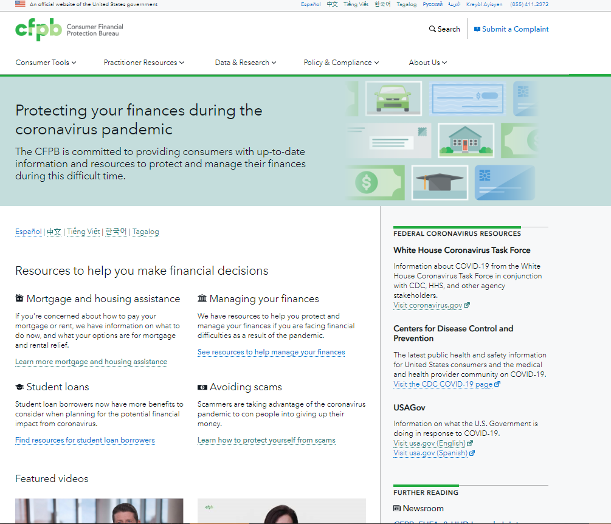
consumerfinance.gov/coronavirus
Central hub on consumerfinance.gov
Resources in English and Spanish, Chinese, Vietnamese, Korean, Tagalog
Short videos
Printer-friendly PDFs for
Asian languages + MP3 audio files
Check back for updates
Notes:
PRE-CLEARED SLIDE for NCLER Webinar 7-20 and ACL-FTC-CFPB Webinar 10-20

Slide 30
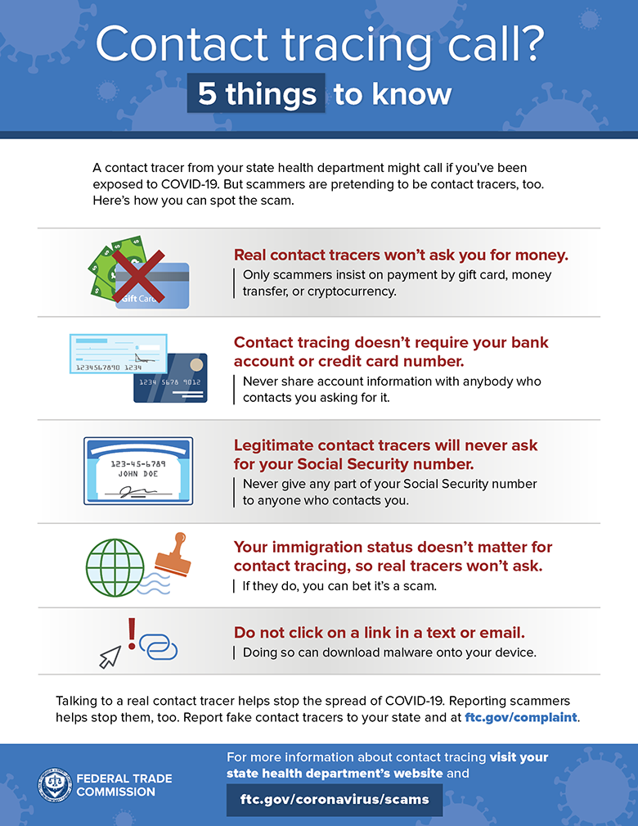
Coronavirus healthcare scams
COVID vaccine scams
Test kit offers
Air filter systems
Government imposters
Notes:
PRE-CLEARED SLIDE for NCLER Webinar 7-20
Note: “Contact-tracing call” info-graphic is new from the FTC. It’s available for anyone to use and since this is a joint webinar with FTC, it seems particularly appropriate to use in this presentation. It was not included in the NCLER webinar slide.

Slide 31
Staying connected
Phone calls and video chats can help you connect during this period while health officials encourage limiting contact
Check in frequently
Ask questions if your loved one expresses concerns about money or mentions unusual activity
Notes:
Slide content is adapted from a CFPB blog post titled “Tips for financial caregivers during the coronavirus pandemic,” which was cleared and published in March 2020:
https://www.consumerfinance.gov/about-us/blog/tips-for-financial-caregivers-during-coronavirus-pandemic/
Despite the nationwide disruptions being caused by the coronavirus, or COVID-19, we continue our daily work to help older adults and their families. Those who serve as financial caregivers for older adults or people with disabilities may have unique worries and challenges. Older adults are at a higher risk for serious illness from COVID-19 and therefore are more likely to be isolated, which can have financial consequences as well. We’re here with up-to-date information and resources to help protect and manage the finances of those you care for, even if you are now separated from them.
Even during the best of times, some may try to take advantage of an older person. That can include family, friends, neighbors, caregivers, fiduciaries, business people, and others. They may take money without permission, fail to repay money they owe, charge too much for services, or just not do what they were paid to do. These are examples of elder financial exploitation or financial abuse. In challenging times, elder financial exploitation may be even more common. Scammers both known and unknown to their targets often focus on older adults because they may have more assets or regular income in the form of retirement benefits or savings and because they’re often polite and trusting.
If you are unable to be with someone whose money you help manage, due to virus prevention tactics like social distancing and quarantines, here are some tips.

Slide 32
Protecting against fraud while using online or mobile banking
Encourage your loved one to set up security features and preferences, including a strong password
The financial institution may offer services to help you keep an account safe, such as turning off a debit card if you suspect fraud
Some financial institutions offer view-only access for third parties, which can help caregivers monitor bill payments and purchases
Notes:
Content is adapted from the May 5, 2020 CFPB blog post titled “Online and mobile banking tips for beginners,” found at https://www.consumerfinance.gov/about-us/blog/online-mobile-banking-tips-beginners/
Now, let’s talk a bit about online and mobile banking, and how you can help protect your loved one from fraud while using this technology. During the pandemic, use of online and mobile banking has grown and many people new to this technology may need to learn how to use it safely.
If your loved one has an online or mobile account with a bank or credit union, encourage them to create strong passwords and not to use the same password for all accounts. It is important not to use identifying information such as addresses and birthdays in the passwords.
Check with your bank or credit union to learn more about additional protections they may offer, such as the ability to inactivate a debit card if you suspect fraud.
Your loved one’s financial institution may offer the option to set up online view-only access so that you can view their account without making any changes. Being able to see their transactions can help you keep track of their finances, make sure bills are being paid regularly, and keep an eye out for suspicious activity.

Slide 33
Keeping track of spending and savings
Caregivers may not know how much they are spending on caregiving, or may not keep good records during an emergency situation like a pandemic
This can affect the caregiver’s ability to budget accurately
In turn, this can impact the caregiver’s own savings and ability to save going forward
CFPB’s Your Money, Your Goals tools can help with budgeting, savings, and bill planning
Notes:
This is new content.
Text in the notes section is adapted from the Your Money, Your Goals landing page on the CFPB website: https://www.consumerfinance.gov/practitioner-resources/your-money-your-goals/booklets-talk-about-money/
CFPB’s Your Money, Your Goals booklets contain information and interactive tools about important topics such as:
Creating an action plan
Tracking and managing income and spending
Prioritizing bills and expenses
Understanding rights and responsibilities when contacted by debt collectors
Planning how to avoid additional debt
Ordering and reviewing credit reports, and disputing any errors that are found
Responding to identity theft
CFPB also has other tools to help people set financial goals for spending and saving and track progress. This can be helpful for caregivers in managing their own finances, as well as managing the finances of the person they are caring for.

Slide 34
Finding help
Non-profit credit counselors: consumer.ftc.gov/articles/0153-choosing-credit-counselor
HUD-certified housing counseling agencies: hud.gov/findacounselor
Eldercare Resource Locator: eldercare.acl.gov
  May offer respite care resources
  May offer caregiver training courses or caregiver support groups
  May offer help identifying or applying for public benefits
  May offer other types of support for caregivers
Notes:
Some of the content on this slide was recently cleared by Kramer, K. for a Sept. 10, 2020 NCRC webinar.
The bullet points under “Eldercare Resource Locator” are adapted from ACL’s webpage which describes Support Services that can be found using the Eldercare Locator: https://eldercare.acl.gov/Public/Resources/LearnMoreAbout/Support_Services.aspx
People may think they should be able to handle their financial decisions on their own, or they may think they don’t have enough assets to need professional financial advice. However, financial coaching and credit counseling can be very helpful for people who are struggling with their finances.
Non-profit financial counseling or credit counseling agencies and HUD-certified housing counseling agencies usually offer sliding scale fees, where the cost for the service may be based on your income or assets.
The Eldercare Locator is a website you can use to find your local Area Agency on Aging and other aging service providers, which may offer many different kinds of help. These agencies may be able to connect you with respite care services, caregiver training courses or caregiver support groups, public benefits that can help the care recipient and/or caregiver meet their own financial needs, or other types of support for caregivers.
Respite care allows caregivers to take a break while a temporary, or “respite,” caregiver steps in to help the care recipient for a short period of time. Respite care services are valuable because they can help caregivers save time and money, and reduce stress.
Eligibility for some of these services may be based on the income and assets of the care recipient or caregiver, and other services may be available to anyone for free. You can use the Eldercare Locator to find the contact information for the Area Agency on Aging in your area, and reach out to them to learn more.

Slide 35
More information and resources
Notes:
Standard OA slide cleared by Kramer, K. in July 2020 for webinar with DOL-EBSA.
Now I’d like to share some information about a few more CFPB resources, including some new resources related to the pandemic.

Slide 36
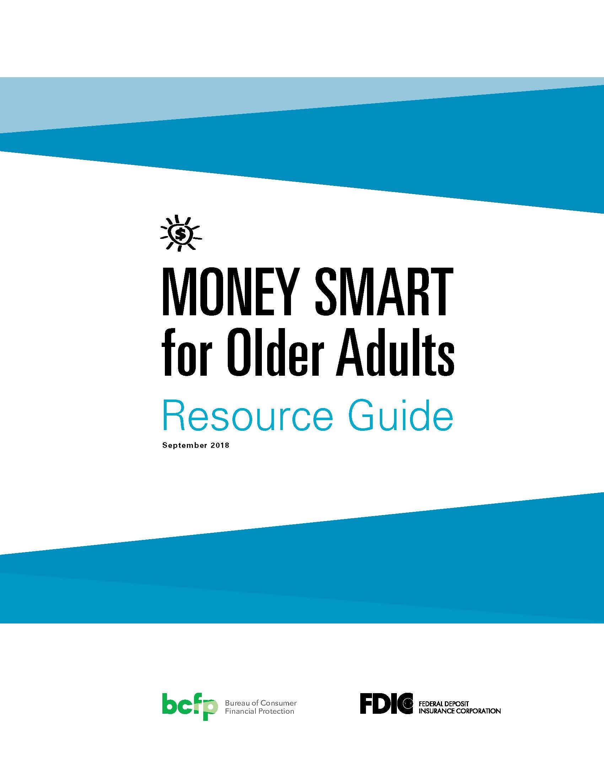
Money Smart for Older Adults
An awareness program developed in collaboration with the FDIC
Identify scams, fraud and other forms of exploitation
Instructor guides available for download
Resource guide available in bulk at no charge
Available in English and Spanish
https://www.consumerfinance.gov/practitioner-resources/resources-for-older-adults/protecting-against-fraud/
Notes:
Standard OA slide, recently cleared by Kramer, K. for a Sept. 10, 2020 NCRC webinar.
Older adults, as well as their family members, should be aware of common types of scams, as well as how to prevent and report them.
Our Money Smart for Older Adults program can help.
Resource Guide is in 14 point font
Can order resources for free in bulk from CFPB
Resource Guide contains:
Information and activities to help learn the material
Tools and instructions to complete the activities
A glossary of the terms
Resources on managing money and reporting financial exploitation
Serves as a stand alone handout for distribution to older people and others
Instructor Guide contains:
Presentation Planning Guide
Icon Guide
Module Overview
Activities
Scams
Summary and Post-Tests
Evaluation Form
Glossary

Slide 37
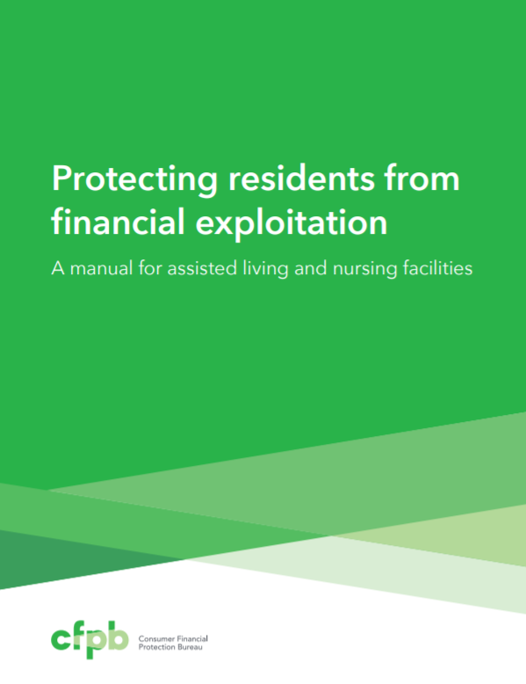
Protecting residents from financial exploitation
This manual provides voluntary ideas to help staff of long-term care facilities prevent, recognize, and report elder financial exploitation.
Features a detailed list of warning signs of financial abuse
Family caregivers can learn about preventing financial exploitation of older facility residents
https://files.consumerfinance.gov/f/201406_cfpb_guide_protecting-residents-from-financial-exploitation.pdf
Notes:
Slide content is adapted from the description of this CFPB resource on Pueblo: https://pueblo.gpo.gov/CFPBPubs/CFPBPubs.php?PubID=13102
Do you have a loved one living in an assisted living or nursing facility?
We have a manual for assisted living and nursing facilities that can help you identify warning signs that may indicate financial exploitation.

Slide 38
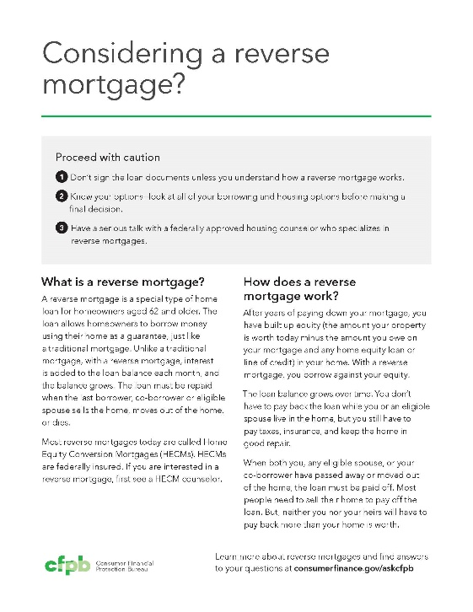
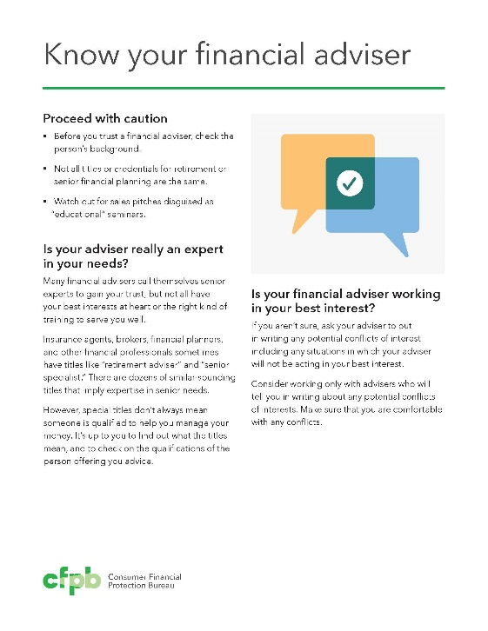
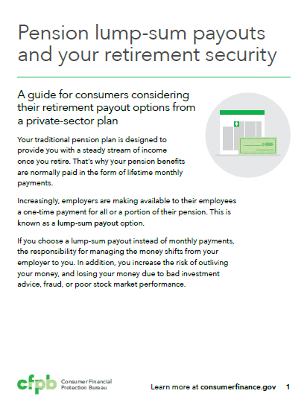
Guides to help consumers make informed decisions
The guides cover topics such as:
  Reverse mortgages
  Financial advisers
  Pension lump-sum offers
The guides list important questions to ask and where to go for help.
Notes:
Standard OA slide cleared by Kramer, K. in July 2020 for webinar with DOL-EBSA.
The guides cover topics such as:
Reverse mortgages
Financial advisers
Pension lump-sum offers
The guides list important questions to ask and where to go for help.

Slide 39

Tips and advice for older consumers
Preparing your spouse to manage family finances
Asset recovery scams
Co-signing student loans
Taking a pension advance
Dealing with medical debt
Planning for diminished capacity
Recognizing misleading claims in reverse mortgage advertising
Responding to debt collectors’ threats of garnishing Social Security benefits
Notes:
Standard OA slide cleared by Kramer, K. in July 2020 for webinar with DOL-EBSA.
We have consumer advisories on all of these topics and more.
Again, you can order in bulk and hand out at events such as Senior Information Fairs, fraud prevention seminars, and more.

Slide 40

Fraud prevention placemats
Free fraud prevention placemats, handouts, and activity sheets on how to avoid common scams
Check out the companion resources with tips and information to reinforce the messages
Available to download or order in bulk
Available in English and Spanish
Consumerfinance.gov/placemats
Notes:
Standard OA slide recently cleared by Kramer, K. for a Sept. 10, 2020 NCRC webinar.
We also offer free fraud prevention placemats, handouts, and activity sheets. We recently released a new suite of materials, which includes bookmarks and table tents.
Originally designed to be used by meal delivery programs, these resources can be used by community groups or individuals in a variety of ways. You can order any of our materials in bulk for free to distribute in your community or to use at a luncheon or other event.
Some of the activities included on the placemats include crossword puzzles, word finds, and other interactive ways to learn about fraud and scams. Our companion resources have tips on ways to start a discussion about these important issues.
Finally, I’d like to share some resources we have related to the coronavirus pandemic.

Slide 41
Contact us
Consumer Financial Protection Bureau
Office for Older Americans
Website: consumerfinance.gov/olderamericans
Email: olderamericans@cfpb.gov
Kate Kramer
Katelyn.Kramer@cfpb.gov
Notes:
Standard OA slide cleared by Kramer, K. in July 2020 for webinar with DOL-EBSA.
You can also join our mailing list to receive occasional alerts about blog posts, network news, funding opportunities and other updates.
Any questions?

